Slide 1

SPIRAL MODEL
Group 7
SE170429 Ngô Xuân Sơn
SE170396 Nguyễn Đức Huấn
SE170302 Trịnh Đăng Khôi
SE170415 Lê Nhật Quang

Slide 2
SPIRAL MODEL
Spiral model is an evolutionary software process model which is a combination of an iterative nature of prototyping and systematic aspects of traditional waterfall model.

Slide 3
HISTORY
The spiral model was defined by Barry Boehm in his 1988 article.
This model was not the first model to discuss iterative development, but it was the first model to explain why the iteration matters.

Slide 4
The following table lists out the pros and cons of Spiral SDLC Model:
Pros :
Changing requirements can be accommodated.
Allows for extensive use of prototypes
Requirements can be captured more accurately.
Users see the system early.
Development can be divided into smaller parts and more risky parts can be developed earlier which helps better risk management.
Cons:
Management is more complex.
End of project may not be known early.
Not suitable for small or low risk projects and could be expensive for small projects.
Process is complex
Spiral may go indefinitely.
Large number of intermediate stages requires excessive documentation.

Slide 5
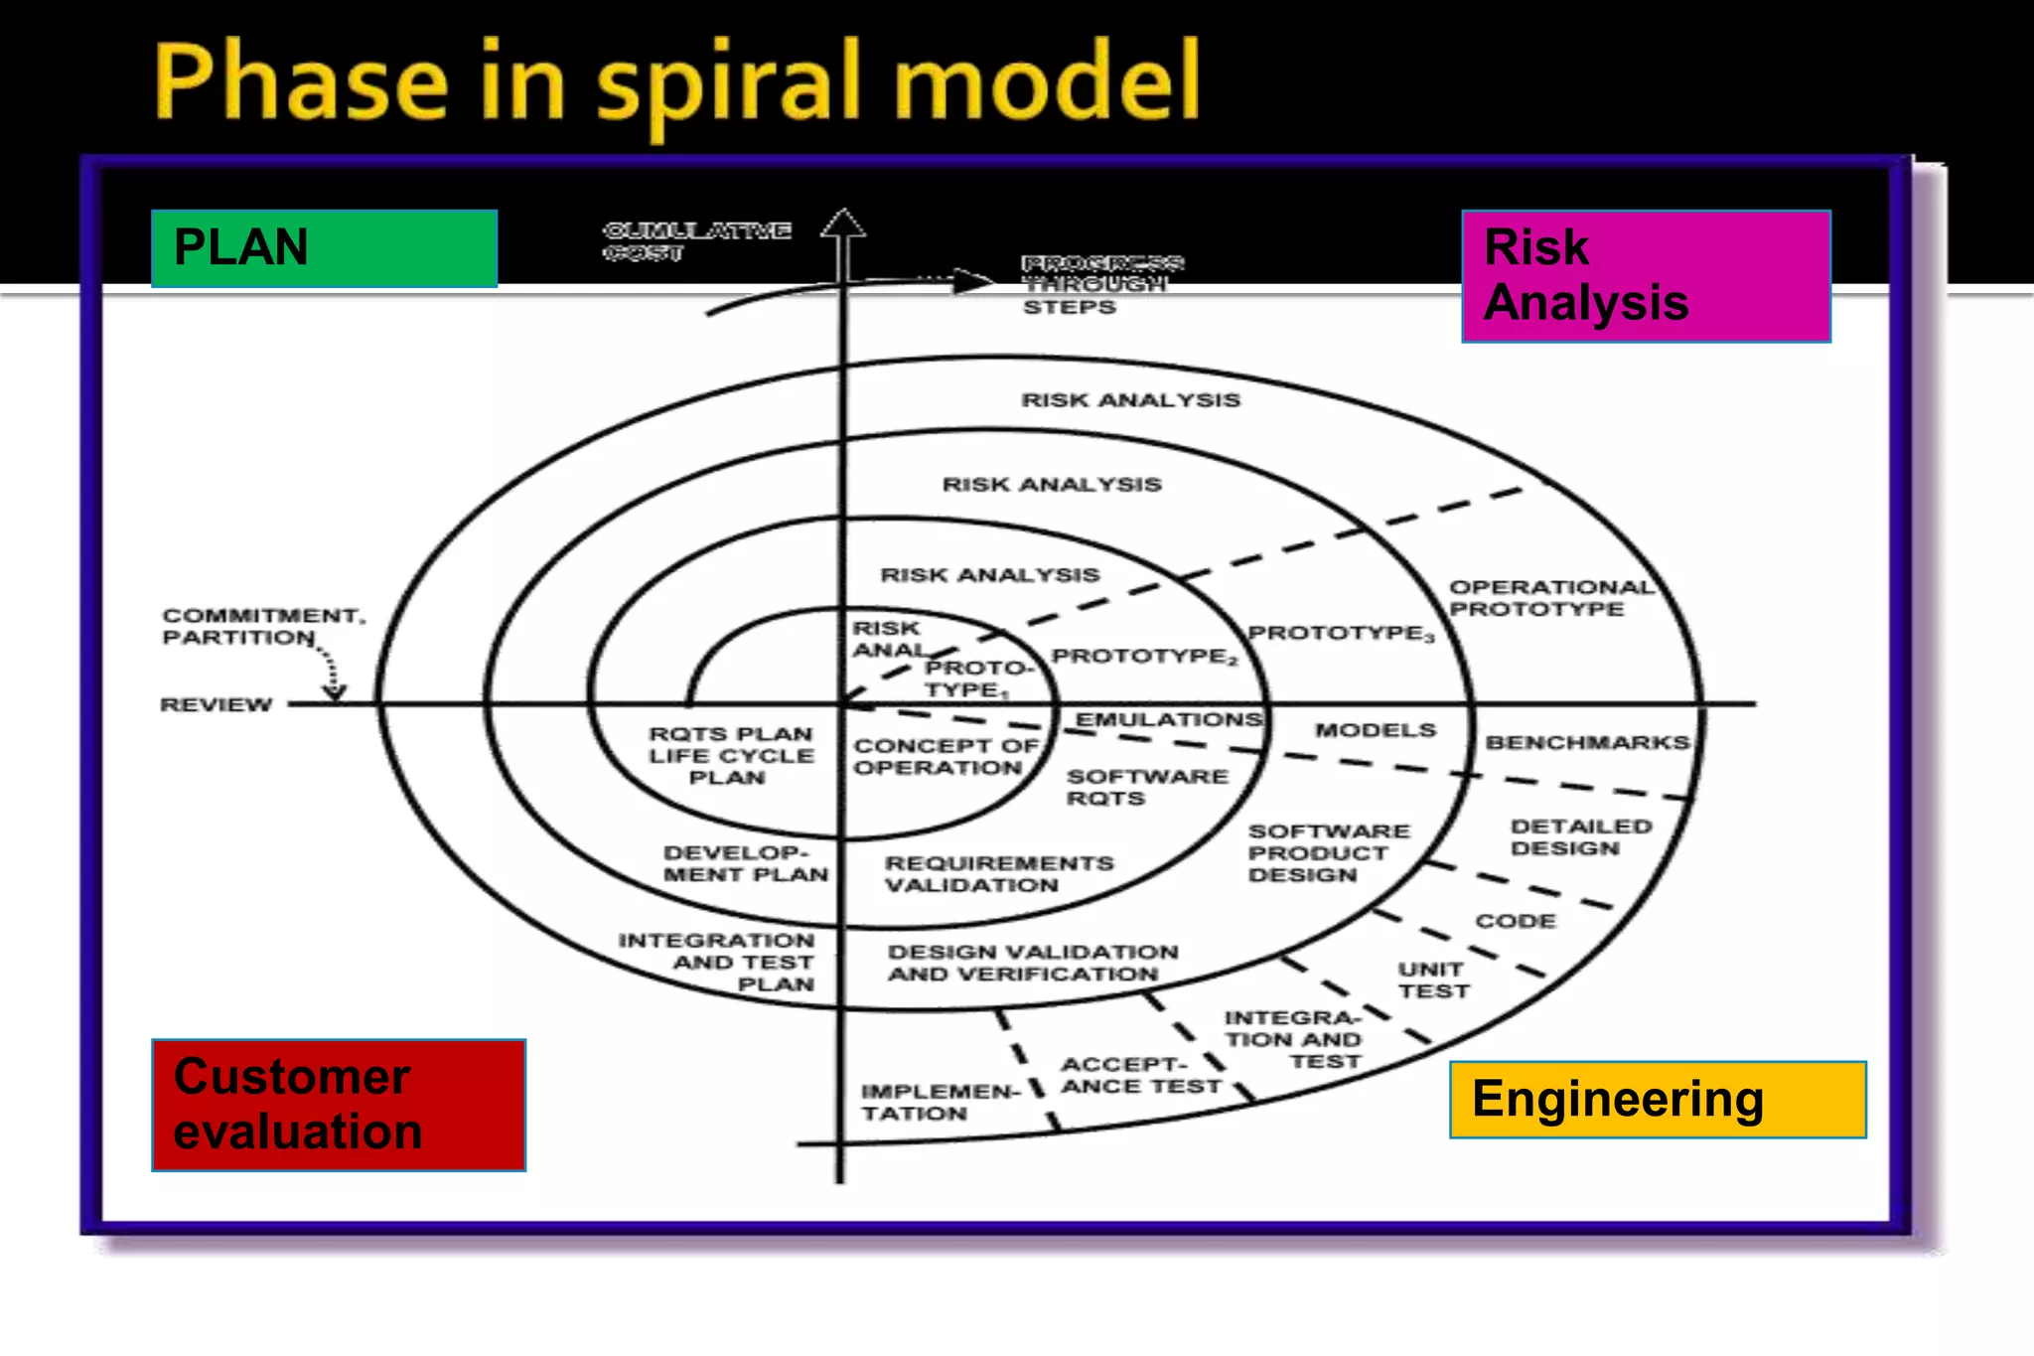

Slide 6
Phases of Spiral Model
Planning:
Purpose: Requirement Analysis
Activities Performed:
- Requirements are studied and gathered.
- Feasibility study.
-Reviews and walkthroughs to streamline the requirements.
Deliverables / Output:
- Requirements understanding document.
- Finalized list of requirements.
Risk Analysis:
Purpose: Prototype
Activities Performed:
- Requirements are studied and brain storming sessions are done to identify the potential risks.
- Once the risks are identified, risk mitigation strategy is planned and finalized.
Deliverables / Output:
- Document which highlights all the risks and its mitigation plans.
Engineering And Execution:
Purpose: Development & Testing
Activities Performed:
- Actual development and testing if the software takes place in this phase.
Deliverables / Output:
- Code.
- Test cases and test results.
- Test summary report and defect report.
Evaluation:
Purpose: Customer Evaluation
Activities Performed:
- Customers evaluate the software and provide their feedback and approval
Deliverables / Output:
- Features implemented document.

Slide 7
THANK YOU

